Slide 1
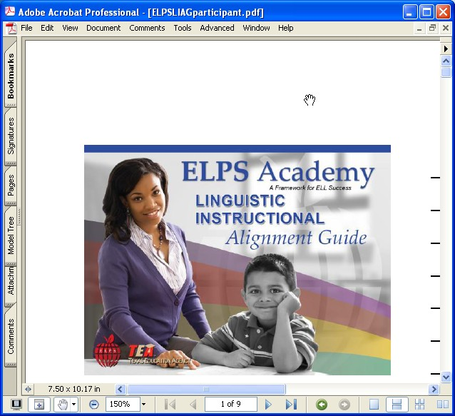
ELPS and the Linguistic Instructional Alignment Guide
Bilingual/ESL Instructional Services
Notes:
Each participant should have a copy of the ELPS Ch.74.4 Sections: Introduction (a), and School district responsibilities (b) only. Linguistic Instructional Alignment Guide (ELPS LIA Guide), and a sample TELPAS data (Confidential Student Roster or student level data by language domain).
Point out that the resources can be found in the ELPS Academy Project Share course via the ELPS Resource supplement within the ELPS section:
http://www.esc20.net/default.aspx?name=ais_ci.ELPS

Slide 2

Creating Language-Rich Interactive Environment
Please...
Today we will:
  Speak in complete sentences
  Avoid saying “I Don’t Know.”

Slide 3
Training Goals
Content Objective
Explore the English Language Proficiency Standards, use a graphic organizer to list the main ideas in the ELPS.
Explore the PLDs
Explore the ELPS Linguistic Instructional Alignment Guide
Language Objective
Discuss the implementation of the ELPS and responsibilities for educators (74.4 a, b) for providing K- 12th instruction based on the student’s linguistic needs and language proficiency levels.
Notes:
Review the goals with participants to model the practice of having objectives reviewed with students prior to a lesson or instruction.
Content objectives describe What content will be learned.
Language objectives describe how the content will be learned.

Slide 4
Self-Assessment of Current Understanding
Rate yourself on the following scale:
This will be my first exposure to the ELPS.
I am somewhat familiar with the ELPS.
I understand what the ELPS are and why they are significant to teachers.
I could explain to someone else what the ELPS are, how they are organized, and what they require of classroom teachers.
Raise your hand when you have selected your response.
I selected . . . because
Notes:
Processes:
Have participants silently read the slide.
Ask participants to raise their hands when they have chosen which statement best reflects their current state of knowledge.
When all hands have been raised, tell the participants to use their fingers to show which number they selected.
Ask the participants to share their answer to someone at their table using the stem:
I selected ___ because . . .

Slide 5

Introduction to ELPS Framework and District Responsibilities
We will explore the key components of the ELPS for providing K-12 instruction to ELL students.
We will discuss the implementation of the ELPS reflecting on the responsibilities of ALL educators to linguistically accommodate instruction.
Notes:
Goals:
To model introducing content and language objectives at the beginning a lesson for the participants.
To introduce participants to the objectives of the lesson.
Processes:
Read the objectives aloud with the participants.
Tell the participants:
“You will be able to explore the key ideas of the ELPS framework through this lesson.”
“You will be able to clearly state your responsibilities as a teacher of ELLs.”

Slide 6
Foldable
Process: Select some of the terms from the next “Word Wall”. You will discuss their meaning and complete the sentence stems by writing them in the corresponding columns
I might be familiar with...” | “I will discover ... ” | “I have learned...”
…the term ELL | … how to … | …
Notes:
Goals:
To model pre teaching vocabulary
To build background to understand the lesson.
To preview new terms
Activity: Create a foldable with 3 columns to organize information using the following sentence stems (Write one stem per column):
“I might be familiar with . . . ”
“I will discover . . . ”
Processes:
Ask participants to discuss the meanings of the terms from the “I might be familiar with . . . ” column.
Ask participants to discuss the meanings of the terms in the “I will discover . . . ” column.
Tell participants we will use and discuss the terms they will include in the next two sentence stems:
in the “I might be familiar with . . . ” column.
in the “I will discover . . . ” column.

Slide 7
Building Vocabulary (Word Wall)
Foldable
English Language Learner
ELPS framework uses the words . . .
Academic Language
Linguistically Accommodated
Communicated
Sequenced
Scaffolded
ELL:
LEP:
ESL:
  TELPAS:
PLD:
Limited English Proficient
English as a Second Language program
Texas English Language Proficiency Assessment
System
Proficiency Level Descriptor; rating of ELLs English skills
Notes:
Goals:
To model pre teaching vocabulary for the participants.
To build background necessary for participants to understand the lesson.
To preview new terms which will be discussed during the lesson.
Activity: Participants will crate a foldable with 3 columns to organize information using the following sentence stems (Write one stem per column):
“I might be familiar with . . . ”
“I will discover . . . ”
“I have learned . . .”
Processes:
Ask participants to discuss the meanings of the terms from the “I might be familiar with . . . ” column.
Ask participants to discuss the meanings of the terms in the “I will discover . . . ” column.
Tell participants we will use and discuss the terms they will include in the next two sentence stems:
in the “I might be familiar with . . . ” column.
in the “I will discover . . . ” column.

Slide 8
Language development standards before were ...
Language development standards now are ...
part of ELA and Spanish language TEKS.
addressed only within ESL/Bilingual programs and only by ESL teachers.
focused on knowledge and skills connected to English Language Arts.
part of every content in the required curriculum.
addressed in all content by all teachers.
focused on knowledge and skills connected to academic language development in the content areas.
Notes:
Goals:
To identify differences between language development standards found in the older ESL TEKS and the current ELPS.
To highlight the fact that teachers in every course in the required curriculum are required to integrate ELPS into content-area instruction.
Processes:
Explain to the participants:
This was how the standards used to be organized.
Language development was mainly addressed within ESL and bilingual programs.
Standards focused on knowledge and skills connected with language arts.
Explain to participants that in December 2007, Texas reorganized the focus of language development for ELLs.
Explain to the participants:
This is how the ELPS are currently organized.
They are part of every course in the required curriculum.
They are integrated into all courses, not just the bilingual or ESL program.
They focus on skills connected to academic language development necessary for all content areas.

Slide 9
Challenges English Language
Learners (ELLs) Face
Numbered Heads Together
  At your tables, number off from 1 to 4.
  Think of an ELL in your classroom.
  Please stand when you can finish this phrase:
    One challenge English Language Learners face
    in the classroom is . . .
  Beginning with number 1, share your sentence with your group.
  When everyone has shared, you may be seated.
Notes:
Goals:
To have participants access prior knowledge about the needs of ELLs.
To model the facilitation of structured conversation.
Processes:
Explain that they will reflection on the needs of ELLs.
Say: You will share your response to the sentence starter with someone from another table.
Choose one participant to model a structured conversation using stems:
Say “My name is . . . ” and “I work at . . . ” and “I think one challenge facing English Language Learners in the Science classroom is . . . ”
Tell participants to find a partner from another table with whom they will share their thoughts.
Give them 4 minutes to engage in the discussion.
Have participants return to their tables.
Ask participants to number off from one to four (or five) at their tables.
Ask the “ones” to share their sentence with their table and then stand.
Randomly select some of the “ones” to share their answers.
Write their responses on chart paper. Participants will consider these challenges throughout the training and will refer to this chart paper poster.

Slide 10
Why the ELPS?
Use page 20 titled “Understanding the ELPS Framework: (1)”
find “Why the ELPS?” (In Resource Supplement).
Silently reflect on the statement you believe best represents the importance of the ELPS.
Stand up as soon as you have made your selection.
Find a partner from another table and discuss which statement you chose and why you selected it. Use the frame:
I selected . . . because . . .
Notes:
Goals:
To discuss research validating the use of language proficiency standards for ELLs.
To have participants recognize the importance of language proficiency standards for ELLs.
Processes:
Ask participants to turn to “Why the ELPS?” on p. 20 of ELPS Resource Supplement.
Ask participants to reflect silently on 1 of the 4 reasons that is most beneficial for ELLs. (Write ahead of time the 4 statements on charts to post at the 4 corners of the room).
Ask participants to stand up as soon as they have made a selection.
Participants locate the poster (on the walls in each of the four corners of the room) that has 1 of the 4 statement they feel is the most significant to them. They will walk over to that poster and visit with other participants who are at the same corner. They will share with each other their reason(s) for selecting the same poster.
Ask for random participants from each group to share their thoughts.
Ask the participants to return to their seats.

Slide 11
ELLs Benefit From...
content-area instruction that is accommodated to their need for comprehensible input.
academic language instruction integrated into content-area instruction.
programs that hold high expectations for students for academic success.
language proficiency standards that provide a common framework for integrating language and content instruction for English learners.
How might the ELPS benefit students who are not ELLs?
Notes:
Processes:
Participants to discuss at their tables: “How might the ELPS benefit students who are not ELLs?”
Randomly ask a few participants to share.

Slide 12

ELPS Framework
Chapter 74.4 English Language Proficiency Standards
Framework and summaries of ELPS
Introduction, District Responsibilities, Student Expectations, and Proficiency Level Descriptors (subsection a, b, c, d)
Notes:
Goals:
To familiarize participants with the organization of ELPS Resource Supplement
To review the subsections of Chapter 74.4 of the TACS

Slide 13
Summary of ELPS Framework:
(Use to take notes)
(a) Big Ideas
(c) Student Expectations
(b) Big Responsibilities
(d)Proficiency Level Descriptors
Notes:
Use this page as a worksheet. Participants will use it to take notes through the presentation
Review how the ELPS contain 4 subsections (a) introduction, (b) District responsibilities, (c) Cross-curricular second language essential knowledge and skills, (d) Proficiency level descriptors.

Slide 14
Getting Acquainted with ELPS PLD’s Matching Activity
ELPS Proficiency Level Descriptors 2nd-12th
* What ELLs are able to do based on language proficiency level.
Work in pairs. Use the template that shows the empty columns with the 4 language domains and the language proficiency levels.
Place the cards with the descriptors in the correct column/row.
Share your results!
* There are ELPS Proficiency Level Descriptors for K-1st grade
Notes:
Puzzle Activity:
Give the participants the copy of the mat (Run on tag and laminate them), and give the cut-up pieces of the Summary chart of the descriptors. Participants will place them in their corresponding blank squares.

Slide 15
Understanding Chapter 74.4. Subsection (a)
Use page 4 from Resource Supplement. Find Ch. 74.4 (a)(1)
  Highlight the second sentence of (a)(1) that begins, “School districts shall implement. . . “
  “ Highlight first sentence of (a)(2) “in order for ELL’s ...”
  Highlight the first sentence of (a)(3) that begins “Classroom instruction that effectively integrate. . . ”
Draw a heart by a(3).
What two things do teachers of ELLs need to integrate?
Notes:
Goals:
Familiarize participants with the main ideas of subsection (a).
To introduce the distinction between making content comprehensible and developing academic language.
Processes:
Have participants turn to page 4 in ELPS Resource Supplement and highlight the second sentence of subsection a(1). Emphasize that implementing the ELPS is not optional for content-area teachers.
Have participants draw a heart by a(3). Explain that subsection a(3) could be thought of as the “heart” of the ELPS. The purpose of implementing ELPS in content-area classes is to provide quality content-area instruction while developing social and academic language skills.
Emphasize that the two goals of ELPS implementation are second language acquisition and quality content-area instruction.
Explain that “Make Content Comprehensible” involves supporting student's understanding in the content standards up to the level of understanding they need to have. Teachers should use specialized techniques: movement, differentiation, and gestures, that we use to help students understand content-area standards.
Explain that “...develop Academic Language” refers to the verbal interaction ELLs need in order to be successful in listening, speaking, reading, and writing.

Slide 16
Curriculum Requirements
Chapter 74.4. (a) (6)
The English language proficiency levels of beginning, intermediate, advanced, and advanced high are not grade-specific. ELLs may exhibit different proficiency levels within the language domains of listening, speaking, reading, and writing.
The proficiency level descriptors outlined in subsection (d) of this section show the progression of second language acquisition form one proficiency level to the next and serve as a road map to help content area teachers instruct ELLS commensurate with student’s linguistic needs.
Notes:
Reference the Texas Administrative Code 19, Chapter 74.4 (Curriculum requirements) ELPs and make connections with the components in the ELPS LIA Guide.

Slide 17
Curriculum Requirements Chapter
74.4 (b)(1)
Requires that school districts identify the student’s English language proficiency levels in the domains of listening, speaking, reading, and writing in accordance with the proficiency level descriptors for the beginning, intermediate, advanced, and advanced high levels.
Notes:
Reference Texas Administrative Code 19, Chapter 74.4. (Curriculum Requirements) ELPS and make connections with the components in the ELPS LIA Guide.
Section (b)(1)District responsibilities, emphasizes that to effectively support ELLs, teachers shall identify students levels of English proficiency. Knowing students English language proficiency levels will assist teachers in determining the support and linguistic accommodations that students may require to be successful.

Slide 18
Understanding subsection (b) District Responsibilities
Read section (b)(1). Highlight all the words of this section.
Read section (b)(2). Highlight “linguistically accommodated (communicated, sequenced, and scaffolded commensurate with the student’s ...”
  Read section (b)(3). Highlight “skills in subsection (c)”.
  Read section (b)(4). Highlight “intensive, ongoing, foundational second language acquisition ... In grade 3 or higher”.
Notes:
Goals: To introduce participants to the responsibilities outlined in subsection (b). To make connections to the components of the ELPS LIA Guide.
District Responsibilities
Turn to page 4 of ELPS Resource Supplement. Read section (b) (2)
This section emphasizes that classroom instruction should be based on the language needs of students to ensure content comprehension.
Processing Activity:
Participants use page 4 of ELPS Resource Supplement.
Tell participants to highlight the words indicated on the slide.
Ask: “What are some considerations teachers must take into account when planning instruction for ELLs?”
Possible responses: TELPAS proficiency levels, years in school, LPAC recommendations

Slide 19
Teachers must...
linguistically accommodate instruction.
74.4: (b)(2)
integrate language proficiency student expectations. 74.4: (b)(3)
be involved, as necessary, in intensive English language development for beginning and intermediate ELLs grade 3 or higher.§74.4: (b)(4)
Read, reflect, share key points
of chapter 74.4 (b)
Notes:
Goal: To explain the meaning of the responsibilities outlined in subsection (b) of Chapter 74.4
Processes: Refer the participants to the ELPS document p.4 -17 (in the ELPS Resource Supplement). Ask them to identify and highlight 74.4: (b)2, (b)3, (b)4, then discuss at the table.
Explain the meaning of linguistically accommodated instruction.
Accommodations are changes in the instructional approach while modifications are changes to the standards being taught.
Linguistic accommodations are changes to the instructional approach based upon the language differences of English learners.
Inform the participants that they will be given strategies to facilitate this process in the next lesson.
Explain to the participants that intensive English language development involves systemic planning at a campus and district level. Content-area teachers should be part of this process.

Slide 20

Linguistically Accommodated Instruction
Supplementary materials (manipulatives, charts, realia)
Instructional delivery
Tasks based on the student’s
current level of language proficiency
Read p.18 Summaries of ELPS. Subsections (a, b, c)
Notes:
Processing Activity:
Direct participants to p. 18 of “Summaries of ELPS Introduction, District Responsibilities and Student Expectations” (in the ELPS Resource Supplement), walk them through the subsections to see the connections between sections (a, b and c) to linguistically accommodate instruction.
Supplementary materials are used to promote to comprehension, communicate content and support language development (examples- illustration charts, manipulatives, and realia.)
Could give Elementary science matching cards or H.S. Science dice for water cycle.
Instructional delivery is the way you choose to deliver the lesson. For example, before presenting new content a teacher might activate prior knowledge, identify misconceptions, review content, review word walls, identify cognates, model/demonstrate.
Processing activity: Think-Pare-Share= Ask participants to provide examples of supplementary materials, instructional delivery and tasks based on their student’s level of language proficiency.

Slide 21

What Are Your Plans to Linguistically Accommodate Instruction?
Read p. 18. Student expectations section of ELPS Resource supplement and highlight strategies and skills under each of the 4 domains that you will cover more this school year, and that maybe in the past you have not covered in depth.
Think-Pair-Share

Slide 22

Using the Linguistic Instructional Alignment Guide
See connections:
English Language Proficiency Standards (ELPS)
ELPS-TELPAS Proficiency Level Descriptors (PLD’S)
Linguistic Accommodations
College Career Readiness Standards
(CCRS)
Notes:
Alignment Guide Instructional Tools:
ELPS Proficiency Level Descriptors
Suggested teacher behavior for linguistic accommodations
Suggested Performance-Based Activities
The purpose of this instructional tool is to help you identify the essential components for providing K-12 instruction based on the student’s linguistic needs. The consistent integration of the ELPS, the ELPS-TELPAS Proficiency descriptors (PLD’S), and the College and Career Readiness Standards (CCRS) are critical in lesson planning in order to include linguistic accommodations that will support the academic development of ELLs.

Slide 23
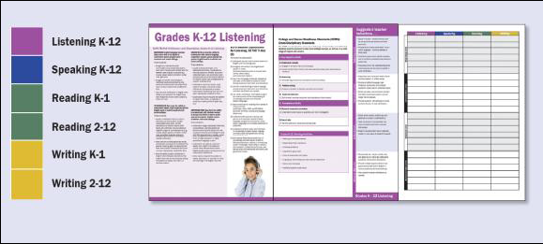
ELPS Linguistic Instructional Alignment
Scavenger Hunt
Notes:
Pass out the ELPS LIAG and the “ELPS Linguistic Instructional Alignment Guide worksheet”
Processing Activity:
Have participants work with a partner to answer all 6 questions that appear on the Scavenger Hunt worksheet (10 min). Allow participants to find the items on the LIA Guide. The objective is for the participants to see the organization of the Guide.
Participants will share their answers (Make sure all 6 questions are answered). TRAINER DOES NOT PROVIDE THE ANSWERS TO THE QUESTIONS. Tell the participants to pay attention and check their answers as the presentation progresses, because the questions will be answered throughout the presentation.

Slide 24
ELPS Linguistic Instructional Alignment Guide Scavenger Hunt
Use the Linguistic Instructional Alignment Guide to complete the Scavenger Hunt Worksheet.
Notes:
Pass out the ELPS LIAG and the “ELPS Linguistic Instructional Alignment Guide Scavenger Hunt worksheet.” Have participants work with a partner to answer all 6 questions that appear on the Scavenger Hunt worksheet (10 min). Allow participants to find the information on the LIA Guide. The objective is for the participants to see the organization of the Guide.
Processing Activity:
Participants will engage in a Scavenger Hunt where they identify the following components: ELPS, PLDs, Linguistic Accommodations (Suggested Teacher Behaviors), and CCRS throughout the ELPS LIA Guide.
Participants will share their responses.
Review the Guide’s layout with the participants.
Participants will share their answers (Make sure all 6 questions are answered). TRAINER DOES NOT PROVIDE THE ANSWERS TO THE QUESTIONS. Tell the participants to pay attention and check their answers as the presentation progresses, because the questions will be answered throughout the presentation.

Slide 25
Alignment of Components
Partner A and B will...
Explore the aligned components.
Compare and contrast the similarities and differences between the K-1st and the 2nd-12th grade Reading and Writing PLD’s.
Find the linguistic accommodations.
Describe the format to your partner.
Notes:
Reference the inside cover which includes a description of the instructional tool, as well as the 4 color-coded sections of the linguistic domains. Participants will scan the arrangements of the aligned components. Point out the format of the PLD’s, ELPS, CCRS, and the Suggested teacher behaviors (linguistic accommodations) as the format will be the same for all language domains.
Reference the K-1st grade-level clusters for Reading and Writing. Allow participants to scan de K-1st and 2nd-12th PLD’s to see how they are both developmentally and grade level appropriate.
Activity:
Participants will work in pairs to discuss the similarities and differences between the K-1st and 2nd-12th grade Reading and Writing PLD’s they will identify.
Participant sentence stems:
“One similarity I noticed between the K-1st and 2nd-12th Reading PLD’s is...”
“One difference I noticed between the K-1st and 2nd-12th Reading PLD’s is...”
“One similarity I noticed between the K-1st and 2nd-12th Writing PLD’s is...”
“One difference I noticed between the K-1st and 2nd-12th Writing PLD’s is...”

Slide 26
Compare and Contrast PLD’s
Work in groups:
Create a graphic organizer to compare and contrast
Compare and contrast the similarities and differences between the K-1st and the 2nd-12th grade Reading and Writing PLD’s.
Use the sentence stems to share your organizers:
“One similarity I noticed between the K-1 and 2-12 Reading PLD’s is...”
“One difference I noticed between the K-1 and 2nd-12 Reading PLD’s is...”
“One similarity I noticed between the K-1 and 2-12 Writing PLD’s is...”
“One difference I noticed between the K-1 and 2-12 Writing PLD’s is...”
Notes:
Activity:
Participants will create a graphic organizer to discuss the similarities and differences between the K-1st and 2nd-12th grade Reading and Writing PLD’s (Example: Venn Diagram, T-Chart, etc).

Slide 27

Monitoring Progress
The ELPS require that linguistic accommodations used during instruction be monitored and adjusted as needed during the school year as students reach higher proficiency levels and/or become familiar with the content.
Notes:
The monitoring and adjusting of instruction is critical for the success of ELLs.
Teachers should be consistently checking for progress since the goal is to have students move across the language continuum.
Say: “The benefit of this laminated tool(LIAG booklet) is that it provides a means for allowing teachers to move students along the Proficiency as they progress through language levels”.

Slide 28
ELPS-TELPAS Proficiency Level Descriptors Subsection (d)
See p.19 of Resource Supplement
The PLD’s describe how well ELLs at each proficiency level are able to understand and use English to engage in grade-appropriate academic instruction.
There are separate PLD’s for listening speaking, reading and writing.
Advanced High
advanced
intermediate
beginning
Best teaching practices
Notes:
Proficiency levels may also vary within language domain. For example, you may have a student displaying Advanced characteristics in Listening, while their Writing displays an intermediate level of proficiency.
Because of this, it is vital that classroom instruction be commensurate to student’s linguistic needs and or correlated with their level of language proficiency in each domain.

Slide 29
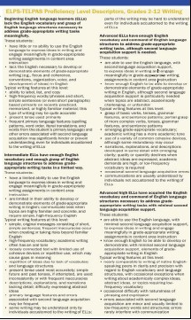
ELPS-TELPAS Proficiency Level Descriptors Chapter 74.4 Subsection (d)
These descriptors define the stages of second language acquisition and are called English language proficiency levels
Now identify the ELPS -TELPAS PLDs for the rest of the language domains
Notes:
Important: the English language proficiency levels of Beginning, Intermediate, Advanced and Advanced High are not grade-specific. There are specific PLDs for each language domain.
Activity: Review this screen shot with the writing example and have participants identify the ELPS-TELPAS PLDs for the remaining language domains.

Slide 30
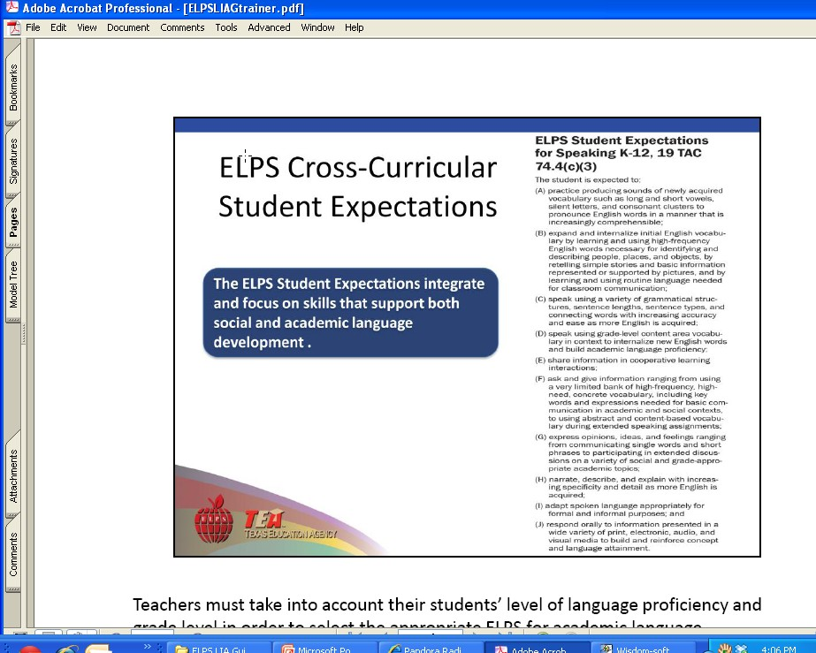
ELPS Cross-Curricular Student Expectations(c)
The ELPS Student Expectations integrate and focus on skills that support both social and academic language development
Now identify the ELPS Cross Curricular Student Expectations for the remaining language domains.
Notes:
Teachers must be purposeful when taking into account the student’s level of language proficiency. This will help them select the appropriate ELPS for academic language development.
The ELPS are not grade specific.

Slide 31
Chapter 74.4 (c)(3)
Activity: Assign Language Domains
Group by your assigned language domain (Listening, Speaking, Reading and Writing).
In your assigned group, identify the ELPS that a Beginning and an Intermediate ELL may need then brainstorm a classroom activity that would promote language development.
Notes:
Teachers must be purposeful when taking into account the student’s level of language proficiency. This will help them select the appropriate ELPS for academic language development.
The ELPS are not grade specific.
Processing activity:
In your assigned group, identify the ELPS that a Beginning and/or Intermediate ELL may need, then brainstorm a classroom activity that would promote language development.

Slide 32

College and Career Readiness Standards
The CCRS represent a full range of knowledge and skills students are expected to know and be able to do, in order to succeed in entry-level college courses, as well as in a wide range of majors and careers.
It is necessary that teachers consider these standards in instructional planning.
Notes:
The CCRS provide competencies and skills that graduating students must possess to continue their education beyond high school. It is necessary that teachers consider these standards in instructional planning.

Slide 33
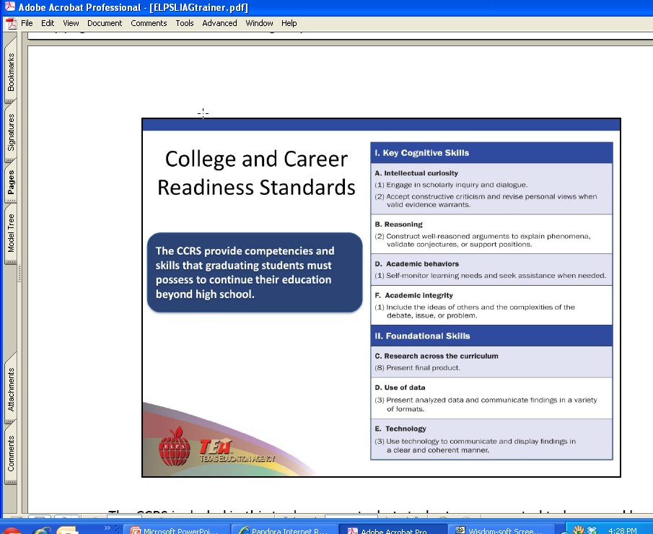
College and Career Readiness Standards
The CCRS are aligned to each linguistic domain, and represent competencies and skills that graduating students must have to continue their education beyond high school.
Now, identify the CCRS for the remaining language domains
Notes:
The CCRS included in this tool represent what students expected to know and be able to do, an are aligned to each linguistic domain.
Review the screen shot for the speaking domain and have participants identify the CCRS for the remaining language domains.

Slide 34
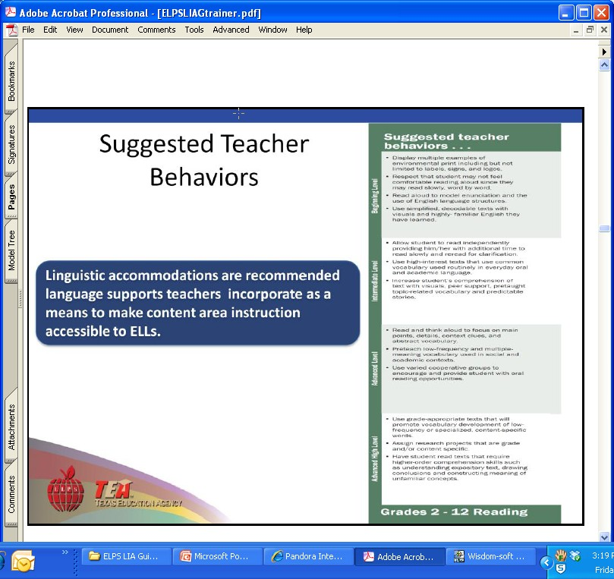
Suggested Teacher Behaviors
Linguistic accommodations are recommended language supports, which teachers incorporate as a means to make content area instruction accessible to ELLs.
Now identify the Suggested Teacher Behaviors for the rest of the language domains
Notes:
Suggested teacher behaviors are examples of recommended linguistic accommodations to support ELLs at different language proficiency levels during Listening, Speaking, Reading and Writing activities.
They are changes to the instructional approach based upon the language proficiency levels of ELLs. The PLDs describe the English that ELLs are able to understand and use at each language proficiency level. These descriptors guide teachers in providing appropriate linguistic support and accommodations.
Activity: Review the Reading Screen shot example and have participants identify the Suggested Teacher Behaviors for the remaining language domains.

Slide 35
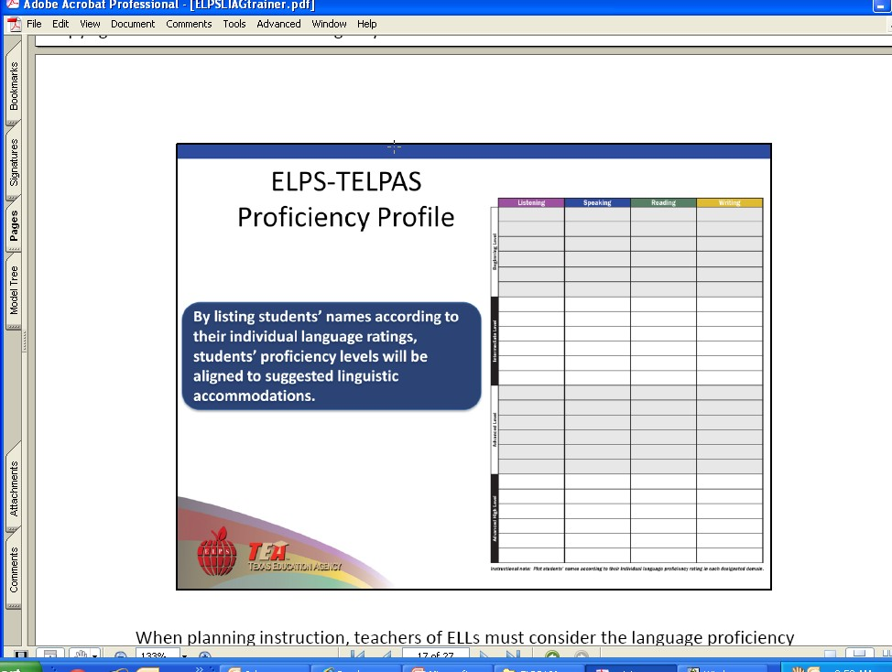
ELPS-TELPAS Proficiency Profile
By listing student’s names according to their individual language ratings, student’s proficiency levels will be aligned to suggested linguistic accommodations.
Notes:
When planning instruction, teachers of ELLs must consider the language proficiency levels of their students as determined be the Texas English Language Proficiency Assessment System (TELPAS).
The ELPS-TELPAS Student Proficiency Profile is a component of the ELPS LIAG that allows teachers to plot students’ TELPAS data by language domain.

Slide 36
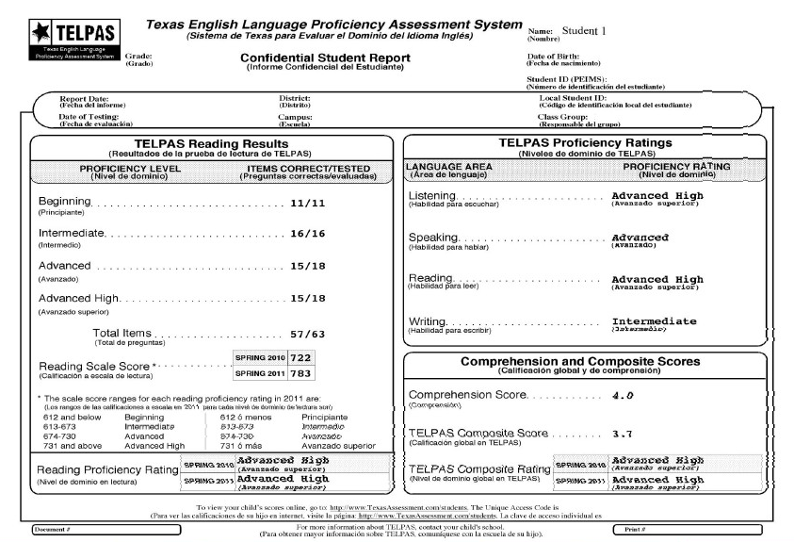
Using TELPAS DATA
The Confidential Student Report indicates the TELPAS proficiency ratings per language domain.
Notes:
The Texas Education Agency (TEA) developed TELPAS to meet state and federal testing requirements. TELPAS assesses ELLs annually in Listening, Speaking, Reading and Writing. Every students who participates in TELPAS receives test results in a report called the Confidential Student Report.
TELPAS uses the four proficiency ratings (Beginning, Intermediate, Advanced and Advanced High) to show the progress students make in learning English from year to year. In order for students to reach their full academic potential, it is important for them to make steady progress in learning English in the four language domains(Listening, Speaking, Reading and Writing).
Students who do not make steady progress may require additional assistance in the areas of both language and content learning

Slide 37
ELPS-TELPAS Proficiency Profile (I Do)
Student 1
Notes:
For each language area assessed, teachers use the PLDs to determine whether the students are at the Beginning, Intermediate, Advanced or Advanced High stage of English language proficiency.
Processing Activity (I Do):
Trainer will point out the language domain of Listening and demonstrate how to plot the language proficiency accordingly on the ELPS-TELPAs Proficiency Profile page.

Slide 38
ELPS-TELPAS Proficiency Profile (We Do)
Student 1
Student 1
Notes:
Processing Activity I Do-You Do-We do:
We do: Ask participants to locate the language domain of Speaking and ask them to plot the language proficiency accordingly on the ELPS-TELPAs Proficiency Profile page.

Slide 39
ELPS-TELPAS Proficiency Profile (You Do)
Student 1
Student 1
Student 1
Notes:
Processing Activity:
Ask participants to locate the language domain of Reading and demonstrate how to plot the language proficiency accordingly on the ELPS-TELPAs Proficiency Profile page.

Slide 40
ELPS-TELPAS Proficiency Profile (You Do)
Student 1
Student 1
Student 1
Student 1
Notes:
Processing Activity:
Ask participants to locate the language domain of Writing and demonstrate how to plot the language proficiency accordingly on the ELPS-TELPAs Proficiency Profile page.

Slide 41
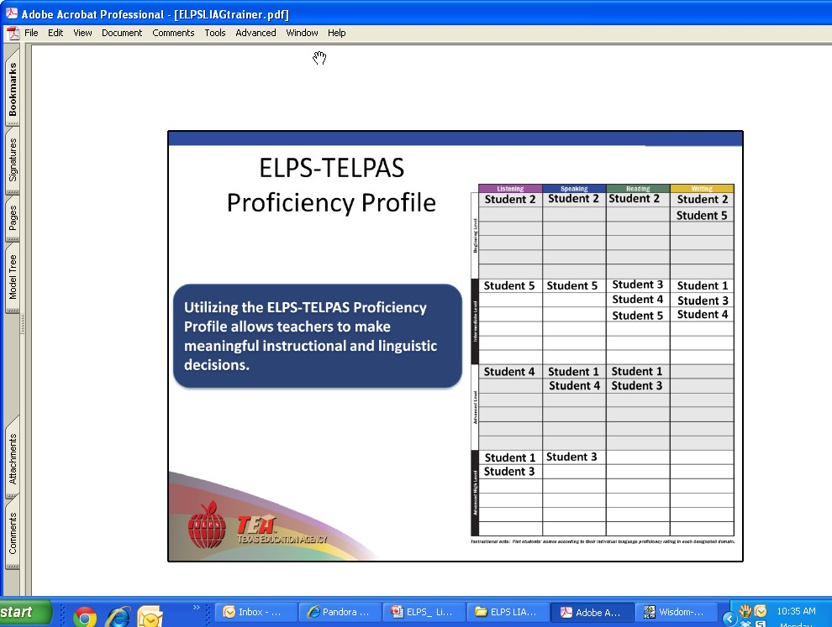

ELPS-TELPAS Proficiency Profile
Utilizing the ELPS-TELPAS Proficiency Profile allows teachers to make meaningful instructional and linguistic decisions.
Drive instruction
Notes:
This ELPS-TELPAS Proficiency Profile allows teachers to gain a bird’s eye view of the proficiency levels of their students in each language domain.
Say: “Please make note that a student may exhibit different proficiency levels of language proficiency in Listening, Speaking, Reading, or Writing. Plotting the proficiency levels of students drives instructional decisions to accommodate for language proficiency.”
Processing Activity (Optional- Ask District/school teacher ato bring some of their student’s TELPAS Reports to plot their current sudents):
Participants will plot student TELPAS data, review the ELPS-TELPAS PLD’s, identify the recommended linguist accommodations (suggested teacher behaviors) for each student and discuss activities that may support language development.

Slide 42


Using the LIAG to Write Lessons
The ELPS Instructional Alignment Guide is designed to help teachers gather information needed to ensure that the classroom instruction meets the individual academic and linguistic needs of ELLs.
Writing language and content objectives in a lesson will contribute to meeting the linguistic needs of ELL students.
Notes:
Language objectives and content objectives should be integrated in a lesson to meet the ELL’s linguistic needs.

Slide 43
Samples of Teacher Behavior for Developing Content Knowledge and Language
Content
Hands-on activities (labs)
Graphic organizers
Learning logs
Realia/Models
Multimedia presentations
Providing native language resources and peer support
Adapted texts
Language
Sentence starters
Structured academic dialogues
Modeling the use of academic language
Writing/talking in complete sentences
ELPS Resource Supplement. Teacher Behaviors p.27, 31, 35, 39, 43, 47
Notes:
Goal:
Understand the distinction between developing content understanding and academic language
Tell participants that these are some of the best practices for developing content knowledge and language.
Processing Activity:
Refer participants to ELPS Resource Supplement, pages 27, 31, 35, 39, 43, 47.

Slide 44
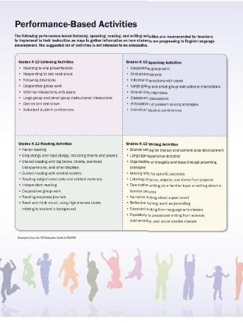
Performance-Based Activities
These activities
are recommended for teachers to implement in their instruction as ways to gather information on student progress.
Notes:
Performance-Based Activities implemented in the classroom are ways to check for progress throughout the school year.
Explain that these activities should be incorporated throughout the year and not solely during the TELPAS Administration window.
Teachers who are part of the TELPAS Holistic Rating training may be familiar with the listed Performance-Based Activities. These Performance-Based Activities can also be found in each language domain individually.

Slide 45


Engaging Performance-Based Activities that Promote Language Development
Science: Putting the Pieces Together-Connection Card Sort
  Kinder-Needs of Organisms
  5th grade-Phase Changes
Math: Comparing Whole Numbers In A Conga Line
  1-5th grade-Whole Numbers and Place Value
Language Arts: Sequencing
  3rd grade-Sequencing Words
  7th grade-Point of View
Social Studies: T-Chart, Pair, Defend
  4th grade-Spanish Missions
Notes:
Optional activity to demonstrate linguistically accommodated lessons: Use the “Navigating the ELPS in the Science, Social Studies, Math, Language Arts and Reading Classroom” by John Seidlitz.
Place Performance Base lessons and activities in Stations by Content Area (Only if time permits. This optional).
The other option is to show and explain how the ELPS are part of the lessons, and to identify the linguistic accommodations in the lesson.
Preparation:
Science: Use Connection cards and Sort cards depending on the grade level. Lesson “Putting the pieces together”- Lesson Card Sort p.37,52,53,54, 55, 56.
Math: Place value mats, base ten blocks, whole number cards (or 3 dice per table) Lesson ”Comparing Whole Numbers in a Conga Line.” p.42, 43,44
Language Arts: Books (“Why Mosquitoes Buzz in People’s ears” and “Qué montón de tamales” ), chart paper, crayons, index cards, sentence strips. Lesson sequencing P. 37, and point of view, p.38
Social Studies: Use a T-Chart, text pages on Spanish missions in Texas, chart page, index cards. Pages 37, 55, 56, 57, 58, 59,60, 61.

Slide 46
Addressing the Needs of Beginning and Intermediate Students
How do I know ensure that I am addressing the beginning and intermediate students in my lessons?
Linguistic accommodations for all lessons:
Go to p.27 of ELPS Resource Supplement to ensure that teacher behaviors for beginner and intermediate students are implemented within the processes of any lesson.
Notes:
Ask participants to follow the next instructions. Say:
Please go to p. 27 of the ELPS Resource Supplement. It addresses what the teacher should to do provide linguistic accommodations.
Select one of the lessons previously discussed in the previous slide.
Place side by side your selected lesson and p. 27 which contains the teacher behaviors.
We will read the first 2 bullets in p. 27 (for the beginner and intermediate level).
We will use them with your lesson to see how teacher behaviors will be implemented within all the domains in all of the activities.
In reviewing your selected lesson, you will use at least two of the bulleted teacher behaviors from each domain. Then you will identify where those teacher behavior will be included within the processes of the lesson.

Slide 47
Performance Base Lessons with Linguistic Accommodations for Beginner & Intermediate
Work with a partner
At your table there are sets of lessons for each content area. Pick a lesson to work with it.
Look at the lesson’s processes (how).
Use p. 27, 31, 35, 39, 43, 47 of the ELPS Resource Supplement on teacher behaviors for beginner and intermediate students
Identify where you can place 2 of teacher behaviors from each domain into the processes of your selected lesson. Where would the behaviors go?
Notes:
Activity:
We will read the first 2 bullets in p. 27 (for the beginner and intermediate level).
We will use them with a lesson to see how teacher behaviors will be implemented within all the domains in all of the activities.
In reviewing your selected lesson, you will use at least two of the bulleted teacher behaviors from each domain. Then you will identify where those teacher behavior will be included within the processes of the lesson.

Slide 48

Share Out
How does this lesson contribute to language development?

Slide 49

Suggested Performance-Based Listening/Speaking Activities
Framed Oral Recap - use sentence stems to discuss what was learned:
“Today I realized…,”
“Now I know…,” or
“The most important thing I learned was…”
W.I.T. Questioning - promote elaboration in discussion, students use 3 stems (Seidlitz & Perryman, 2008):
  “What do you think…?”
  “Is there another…?”
  “Tell me more about…?”
Notes:
The suggested list is not intended to be exhaustive.
Optional: Inside/outside circle- review, discuss information using your organizer with the 4 sections of the ELPS

Slide 50

Suggested Performance-Based Reading Activities
Partner Reading- Partners alternate reading a paragraph . One reads while the other summarizes and/or asks questions.
Scanning- Student scan through text backwards looking for familiar terms. Teacher gives meaning of the terms as it appears in the context.
Native Language Texts –Native language translations or summaries, wordlists, glossaries or related literature to support understanding

Slide 51

Suggested Performance-Based Writing Activities
Graphic organizers – non-linguistic representations to organize information visually helps process and retain information. (Marzano, Pickering,2001)
Read, Write, Pair, Share – students read a text, write their thoughts on it using a sentence starter, pair up with another student, share their writing, and comment on one another's writing. (Fisher & Frey)
Double Entry Journal – Using a 2 column journal, students write in the 1st column, words, phrases, ideas that they find interesting. In the other, they write the reasons, or ways they can use them in their own writing. (Samway, 2006)

Slide 52
Using the LIAG to Write Lessons
Effective instruction in second language acquisition involves providing ELLs opportunities to listen, speak, read and write at their current levels of English development while gradually increasing the linguistic complexity of the English they read, hear and are expected to speak and write.
Notes:
The ELPS Instructional Alignment Guide is designed to help teachers gather information needed to ensure that the classroom instruction meets the individual academic and linguistic needs of ELLs.
Reflection Activity: Participants will identify a component from the ELPS Linguistic Instructional Alignment Guide and how it will contribute to meeting their ELL’s instructional needs to promote language development.
Participants can be divided according to language domain (Listening, Speaking, Reading, Writing).

Slide 53
Contact Information:
Karina Chapa
Director - Language Proficiency, Biliteracy, and Cultural Diversity
kchapa@esc1.net
Perla Roerig
Bilingual/ESL Specialist
proerig@esc1.net
Program Assistant
956-984-6238

